Slide 1
Artificial Intelligence
Name- Rakshit Siddalingappa
Matriculation Number- 11012530
Mentored By,
Dr. Simon Ziegler
Srh Hochschule
Heidelberg

Slide 2
Agenda
Overview: Artificial Intelligence and Machine Learning
Example Use Case – Heart Disease Predictor
Data Set and Profiling
Pre-work: Random Forest
KNN Classifier
Contribution: K-Nearest Neihbour
Conclusion

Slide 3
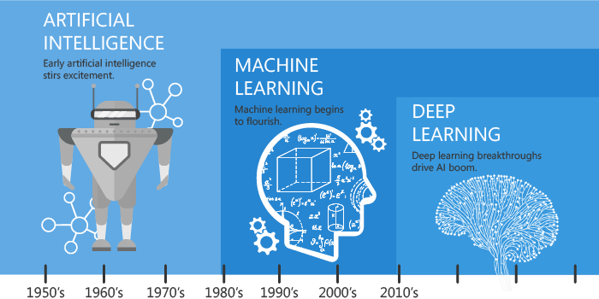
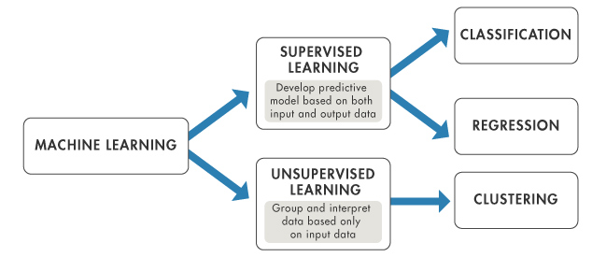
Artificial Intelligence and Machine Learning
Artificial intelligence (AI) is an area of computer science that emphasizes the creation of intelligent machines that work and react like humans.
Some of the activities computers with artificial intelligence are designed for include: Speech recognition, pattern recognition, planning, optimization.
Artificial Intelligence is the science of getting machines to mimic the behaviour of humans
Machine learning is a subset of AI that focuses on getting machines to make decisions by feeding them data
Deep learning is a subset of machine learning in artificial intelligence (AI) that has networks capable of learning unsupervised from data that is unstructured or unlabeled.
Notes:
Deep learning Also known as deep neural learning or deep neural network.
Supervised .- for examples you give information and features to the pictures and that’s called labels (basically we supervise the model with labels and features so the model has learnt.
Unsupervised – we don’t give labels, just give the pictures, so the machine try by itself
Clustering - Clustering is a Machine Learning technique that involves the grouping of data points.
Deep learning Also known as deep neural learning or deep neural network.
3

Slide 4
Overview: Artificial Intelligence and Machine Learning
Machine learning algorithms are used primarily for the following types of output:
Clustering (Unsupervised)
Two-class and multi-class classification (Supervised)
Regression: Univariate, Multivariate, etc. (Supervised)
Anomaly detection (Unsupervised and Supervised)
Recommendation systems (aka recommendation engine)

Slide 5
Machine Learning Algorithms
Supervised Regression
Simple and multiple linear regression
Decision tree or forest regression
Artificial Neural networks
Ordinal regression
Poisson regression
Nearest neighbor methods (e.g., k-NN or k-Nearest Neighbors)
Supervised Two-class & Multi-class Classification
Unsupervised
K-means clustering
Hierarchical clustering
Anomaly Detection
Support vector machine (one class)
PCA (Principle component analysis)
Logistic regression and multinomial regression
Artificial Neural networks
Decision tree, forest, and jungles
SVM (support vector machine)
Perceptron methods
Bayesian classifiers (e.g., Naive Bayes)
Nearest neighbor methods (e.g., k-NN or k-Nearest Neighbors)
One versus all multiclass
Notes:
5

Slide 6
Example Use Case – Heart Disease Predictor Example Use Case – Heart Disease Predictor Example Use Case – Heart Disease Predictor Example Use Case – Heart Disease Predictor
Problem statement:
Given a person’s attribute information can a software system with an intelligent model predict whether the person has a heart disease or not?
Solution:
Supervised machine learning model (Random forest, KNN classifier)
Given:
Data set with 14 attributes including the label (has a heart disease, does not have a heart disease)
Attribute Information:
1. age
2. sex
3. chest pain type (4 values)
4. resting blood pressure
5. serum cholesterol in mg/dl
6. fasting blood sugar > 120 mg/dl
7. resting electrocardiographic results (values 0,1,2)
8. maximum heart rate achieved
9. exercise induced angina
10. ST depression induced by exercise relative to rest
11. the slope of the peak exercise ST segment
12. number of major vessels (0-3) colored by fluoroscopy
13. thal: 0 = normal; 1 = fixed defect; 2 = revers. defect
14. Label
Notes:
Radom forest was already there and KNN was used by me
for example there are 100 people and we have collected the data of all of them.
So with the given data can a computer wit machie learning model give weather he has a heart disease or doesn’t have with the attribution given
6

Slide 7
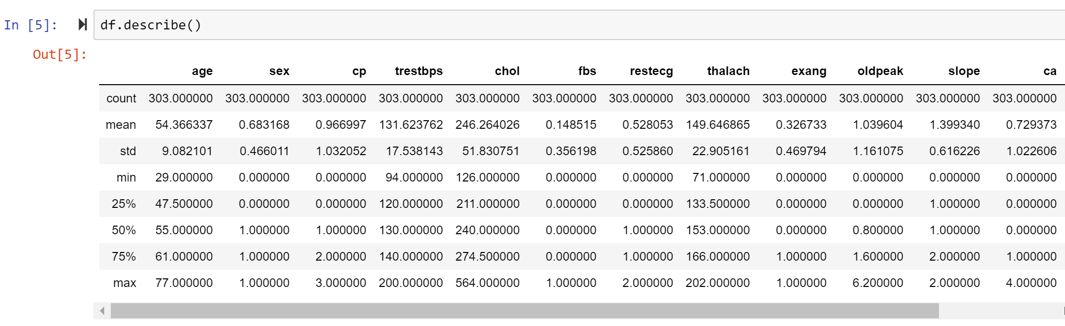
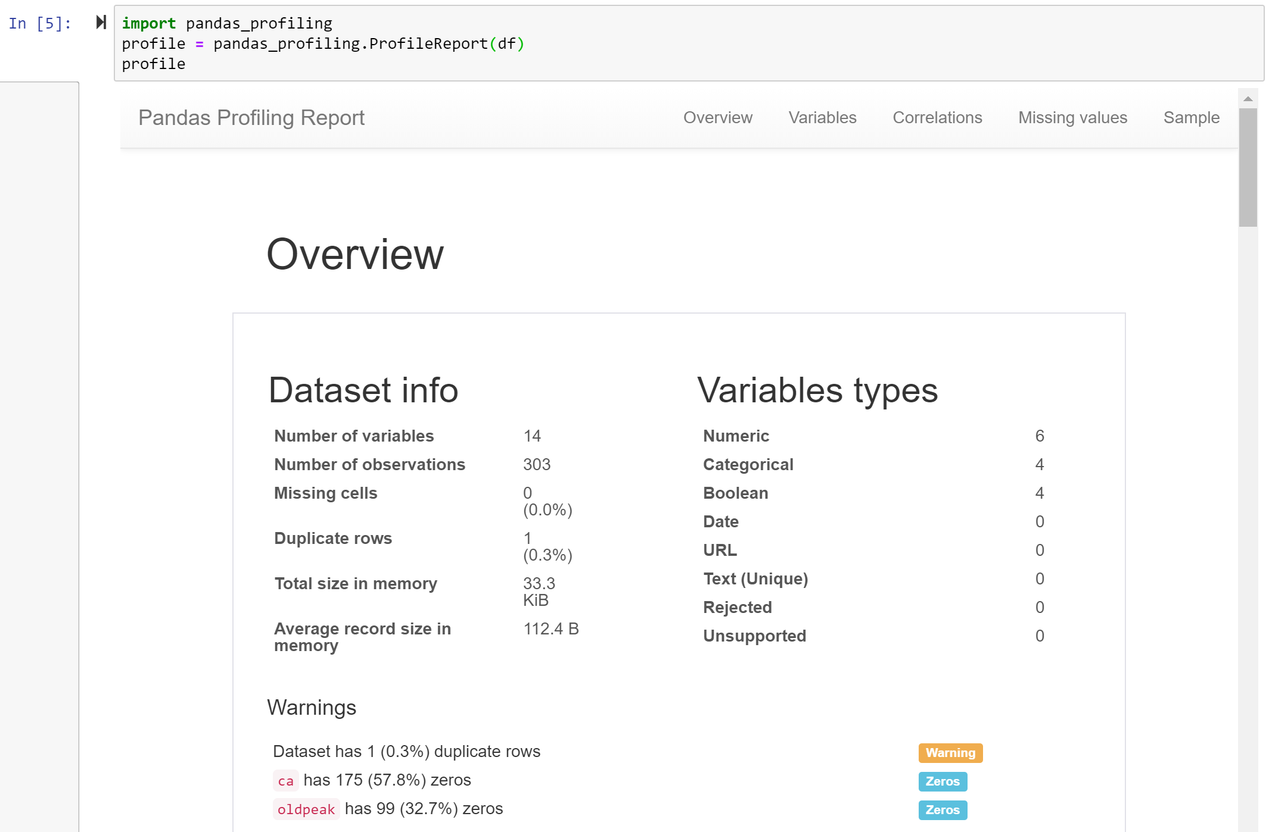
Data Set and Profiling
The data set containing 1025 samples from Kaggle is considered for this study
Notes:
I have used Jupyter notebook and took the exiting code from random forest
Loaded the data in python using this command, so there are nice commands on jupyter notebook with this you can get the profiling
7

Slide 8
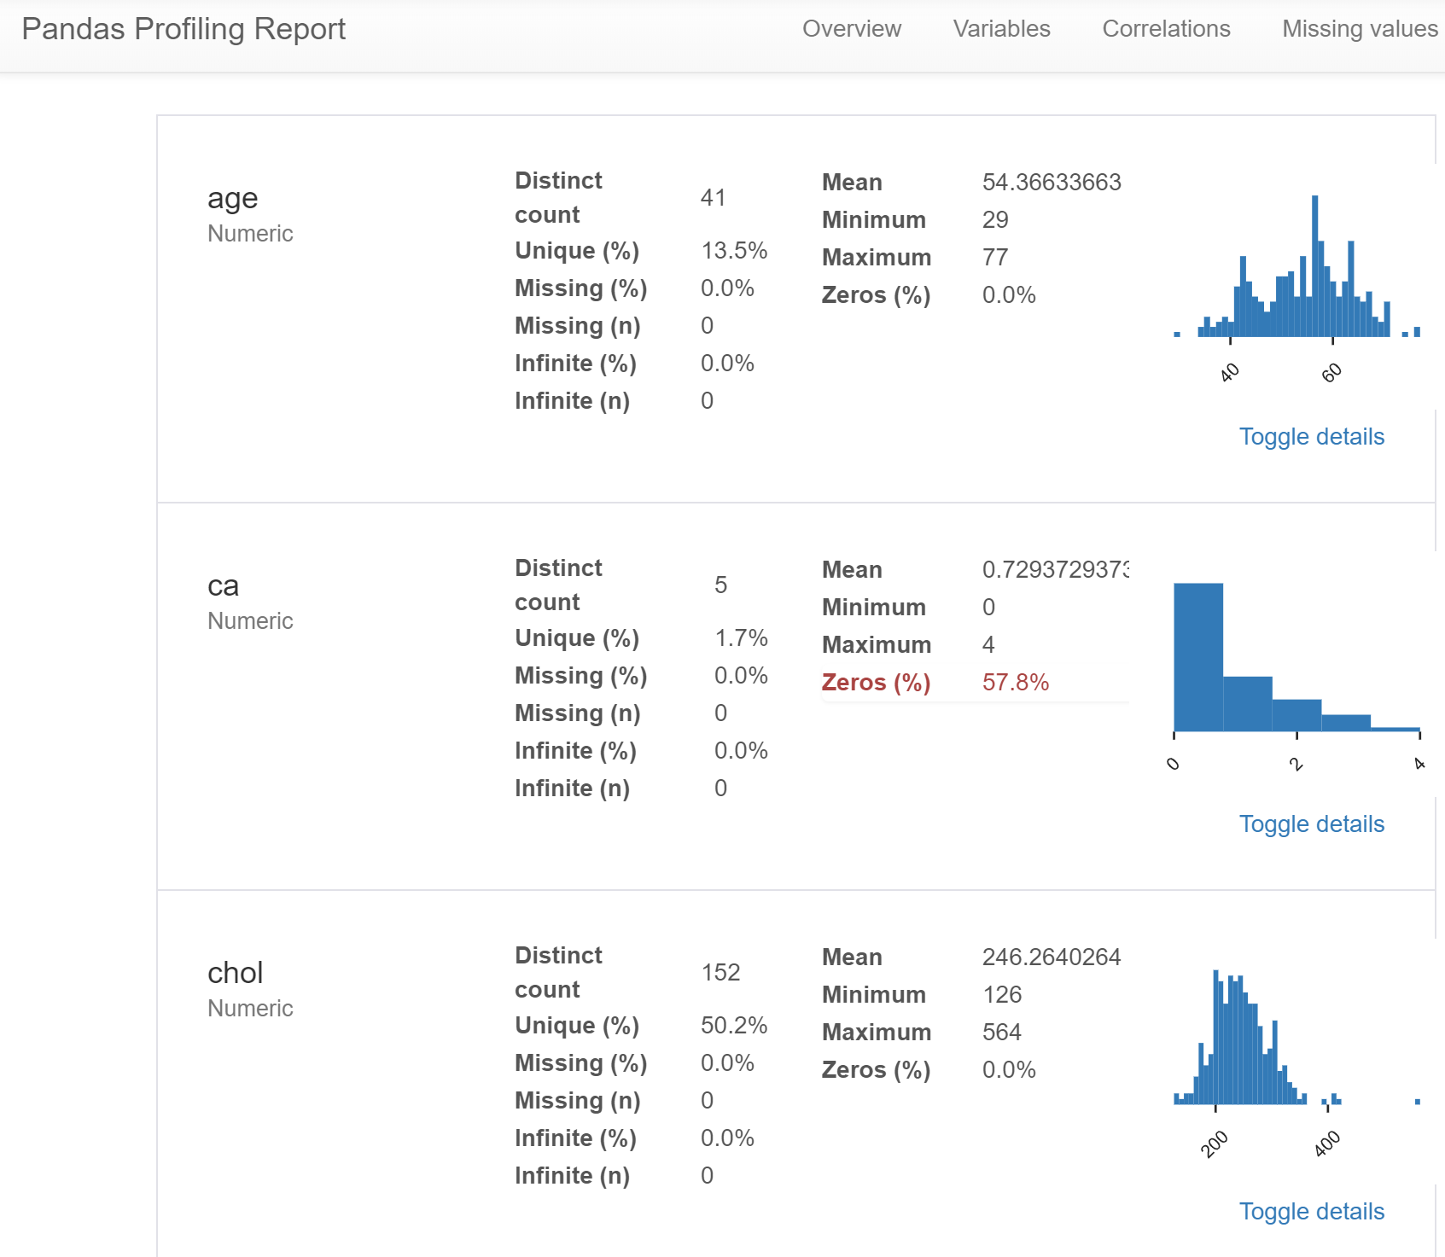
Profiling
Data profiling is a technique used to analyze and gain a better understanding of raw data. It is the first step in determining what insights data can yield when you run it through machine learning algorithms in order to make predictions.

Slide 9
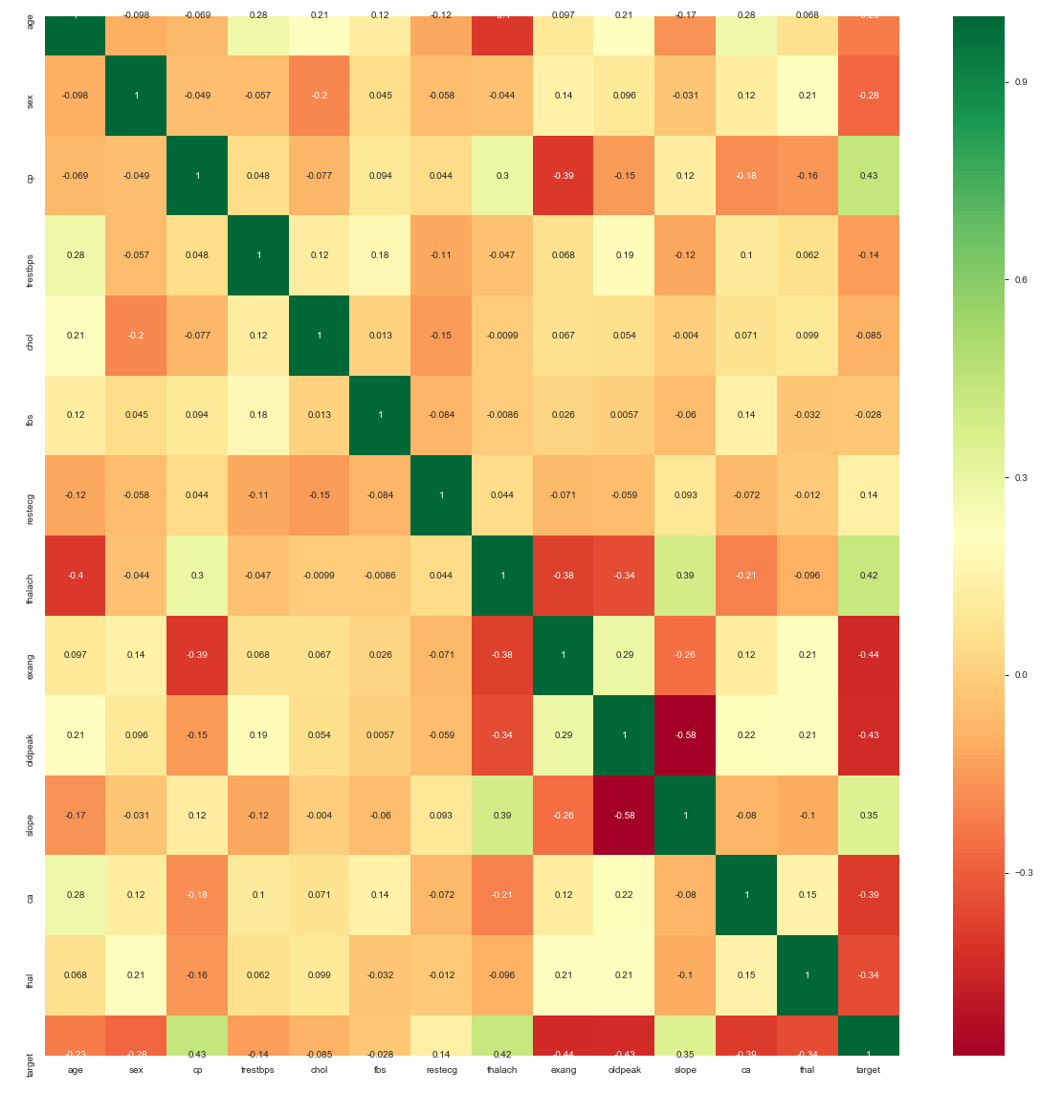
Data Set and Profiling – correlation Heat Map
Notes:
Relation between on eattribute and
Green highly corelated
Red is weekly corelated
9

Slide 10
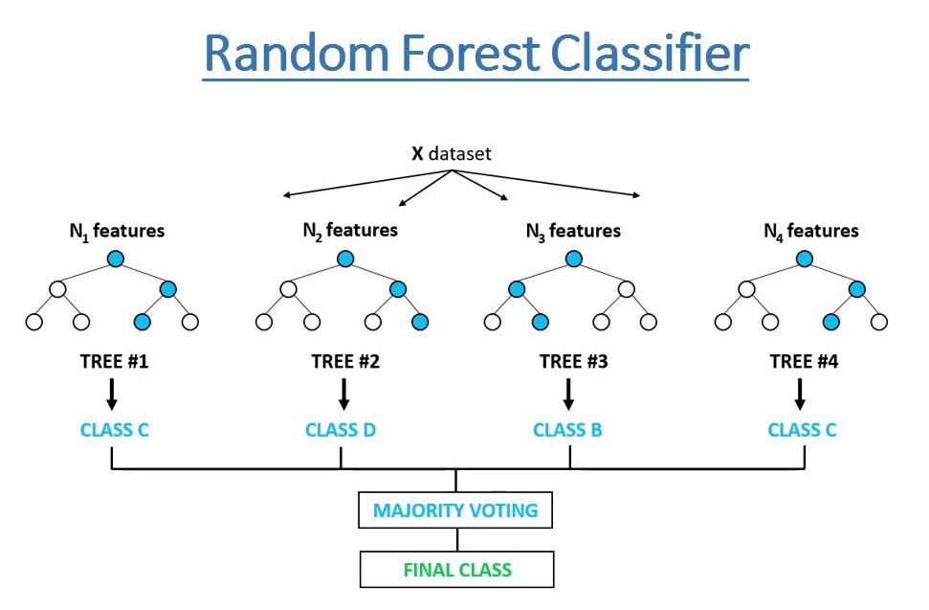
Pre-Work: Random Forest
Random forest is a classification algorithm consisting of many decisions' trees. It uses bagging and feature randomness when building each individual tree to try to create an uncorrelated forest of trees whose prediction by committee is more accurate than that of any individual tree.
Notes:
SO random forest is what they have used and what I have contributed is I tried k nearest amd I have compared both of them, i mean the accuracy
10

Slide 11
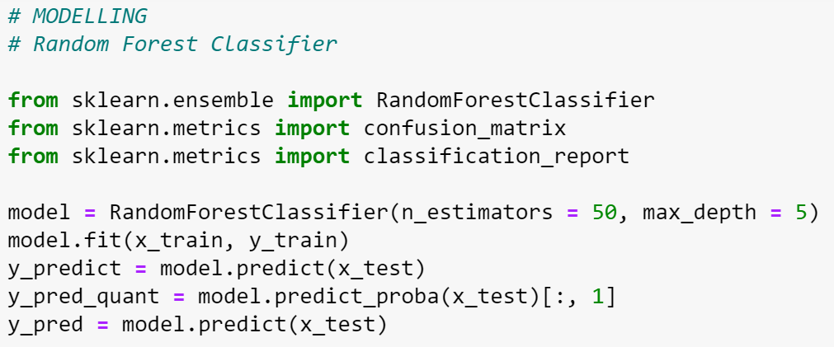
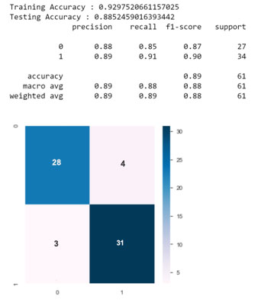
Pre-work: Random Forest

Slide 12
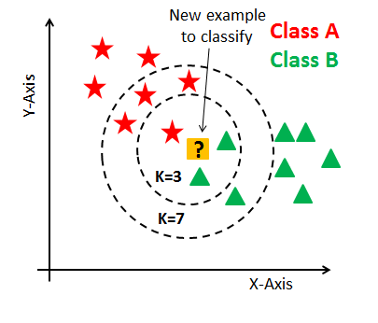
K-nearest Neihbour Classifier
K nearest neighbor algorithm is very simple. It works based on minimum distance from the query instance to the training samples to determine the K-nearest neighbors. ... The data for KNN algorithm consist of several multivariate attributes name that will be used to classify .
Notes:
12

Slide 13
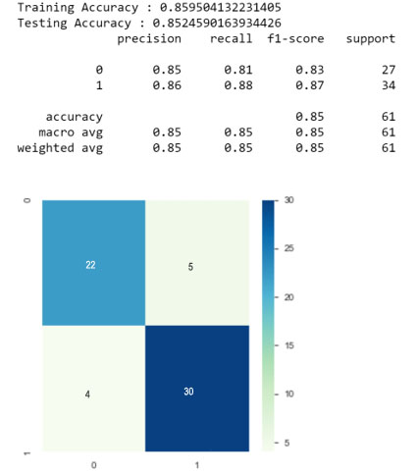
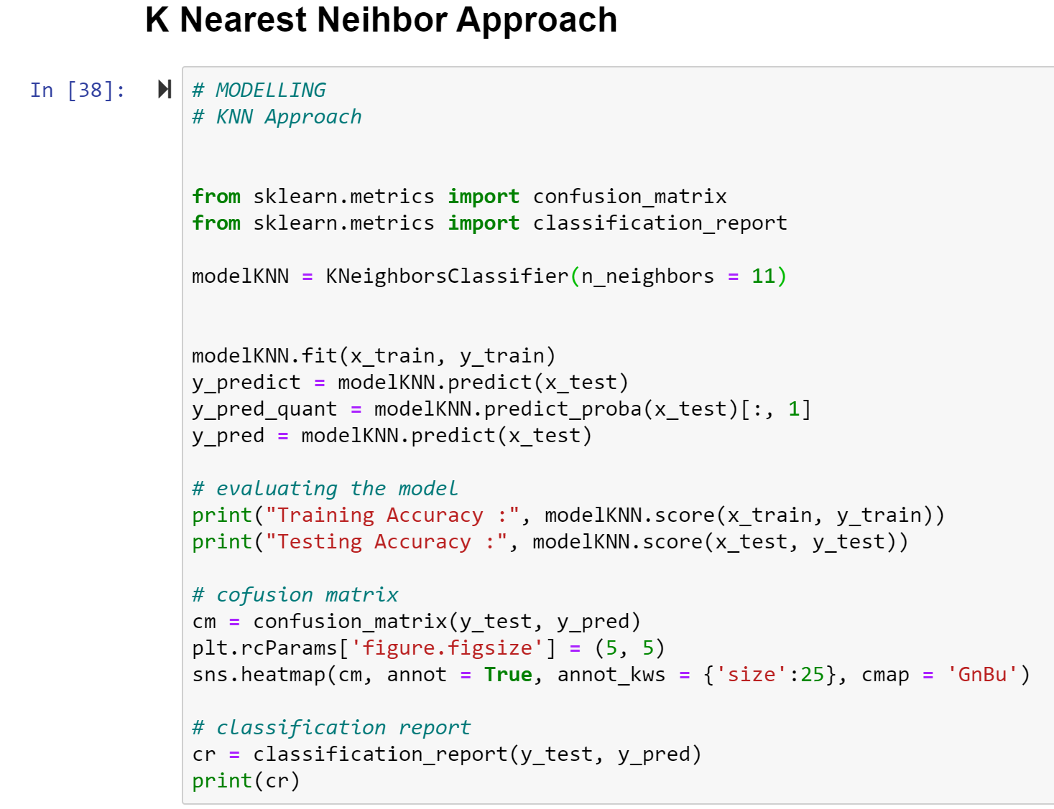
Contribution: K-Nearest Neighbor
In pattern recognition, the k-nearest neighbors algorithm (k-NN) is a non-parametric method used for classification and regression. ... If k = 1, then the object is simply assigned to the class of that single nearest neighbor.
Notes:
Did this using jupyter
Here I took instead of random forest I took KNN approach and gave the parameter as 11 as input, actually tried different ones but 11 happen to e the best outcome.
13

Slide 14
Summary and Conclusion
Data set from Kaggle on heart disease prediction was considered
Existing work done on random forest was considered as the baseline to study about supervised machine learning
Modeled a KNN classifier and tested on the same data set
Conclusion: Accuracy of KNN and Random forest are comparable
(85% and 89% respectively)
Notes:
14

Slide 15
References
https://towardsdatascience.com/understanding-confusion-matrix-a9ad42dcfd62
https://www.kaggle.com/johnsmith88/heart-disease-dataset
https://github.com/krishnaik06/Predicting-Heart-Disease
https://www.youtube.com/watch?v=hTks_Vc0kK0&t=336s
https://www.youtube.com/watch?v=75OJvlhFUMY&t=313s
https://www.kaggle.com/kralmachine/analyzing-the-heart-disease

Slide 16
Any questions?
Thank you

